Slide 1
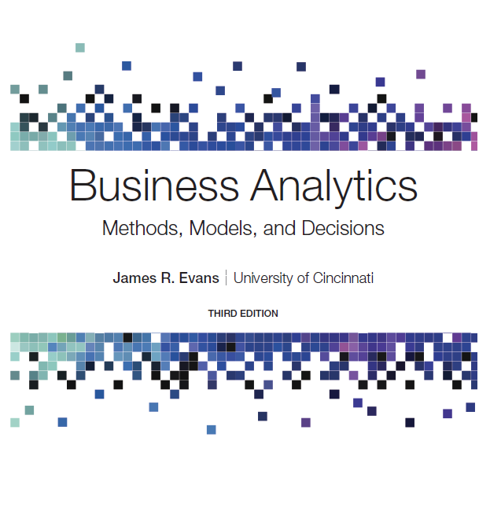
Business Analytics: Methods, Models, and Decisions
Third Edition
Chapter 11
Spreadsheet Modeling and Analysis
Copyright © 2020, 2016, 2013 Pearson Education, Inc. All Rights Reserved
Notes:
If this PowerPoint presentation contains mathematical equations, you may need to check that your computer has the following installed:
1) MathType Plugin
2) Math Player (free versions available)
3) NVDA Reader (free versions available)

Slide 2
Model-Building Strategies
Building decision models is more of an art than a science.
Creating good decision models requires:
solid understanding of business functional areas
knowledge of business practice and research
logical skills
It is best to start simple and enrich models as necessary.

Slide 3
Example 11.1: A Total Cost Decision Model (1 of 3)
From basic business principles, we know that
the total cost of producing a fixed volume of a product is composed of fixed cost and variable cost
the variable cost depends on the unit variable cost as well as the quantity produced
the quantity produced is a decision option

Slide 4
Example 11.1: A Total Cost Decision Model (2 of 3)
Model development:
Therefore:

Slide 5
Example 11.1: A Total Cost Decision Model (3 of 3)
Mathematical representation
C = Total cost
V = Unit variable cost
F = Fixed cost
Q = Quantity produced
This results in the following model:

Slide 6
Building Models Using Influence Diagrams
Influence diagram - a visual representation of a descriptive model that shows how the elements of the model influence, or relate to, others.
The elements of the model are represented by circular symbols called nodes. Arrows called branches connect the nodes and show which elements influence others.
An influence diagram is a useful approach for conceptualizing the structure of a model and can assist in building a mathematical or spreadsheet model.

Slide 7
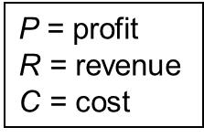
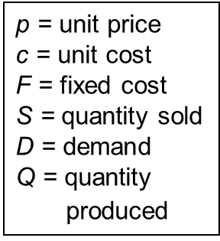
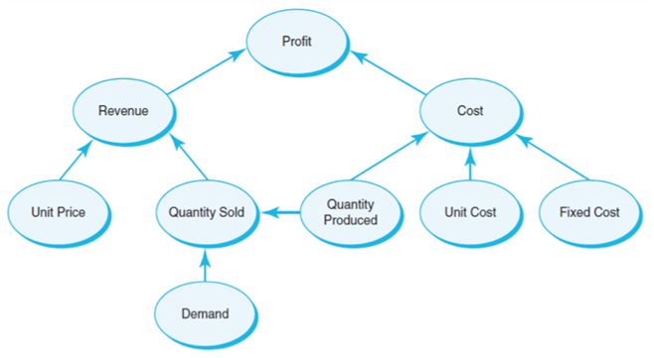
Example 11.2: Developing a Decision Model Using an Influence Diagram
Cost = fixed cost + variable cost
Revenue = price times quantity sold
Profit = Revenue − Cost

Slide 8
Building Models Using Historical Data
Data used in models can come from existing databases and other data sources, analysis of historical data, or surveys, experiments, and other methods of data collection.
Statistical methods are often used to estimate data required in predictive models.
We might use empirical data and line-fitting techniques to build a model.

Slide 9
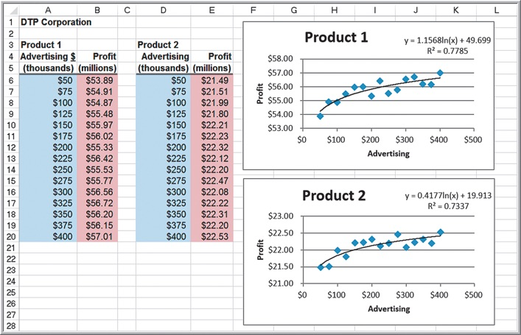
Example 11.3: Building a Decision Model Using Historical Data
D T P Corporation - the effect of media advertising on profits
Logarithmic trendlines
Product 1 Profit
Product 2 Profit

Slide 10
Model Assumptions, Complexity, and Realism
Models cannot capture every detail of a real problem.
Validity refers to how well a model represents reality.
Examine the assumptions made in a model to see how they agree with our perception of the real world.
Compare model results to observed results.
To add more realism to a model generally requires more complexity.

Slide 11
Implementing Models on Spreadsheets
Principles of good spreadsheet design:
Separate the data, model calculations, and model outputs clearly in designing a spreadsheet.
Do not use input data in model formulas, but reference the spreadsheet cells that contain the data. In this way, if the data change or you want to experiment with the model, you need not change any of the formulas, which can easily result in errors.

Slide 12
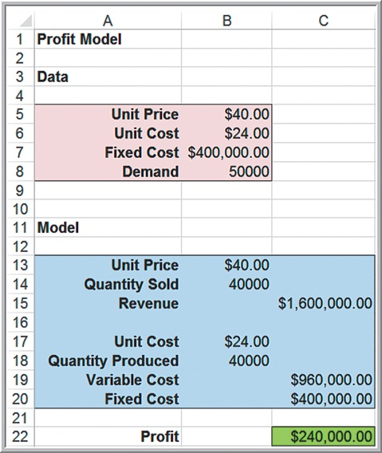
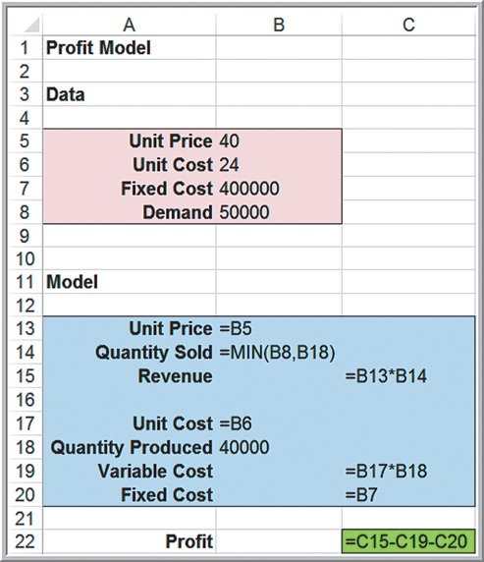
Example 11.4: Spreadsheet Implementation of the Profit Model
Excel file Profit Model

Slide 13
Example 11.5: Modeling Net Income on a Spreadsheet (1 of 4)
Gross profit = sales − cost of goods sold
Operating expenses = administrative expenses + selling expenses + depreciation expenses
Net operating income = gross profit − operating expenses
Earnings before taxes = net operating income − interest expense
Net income = earnings before taxes − taxes

Slide 14
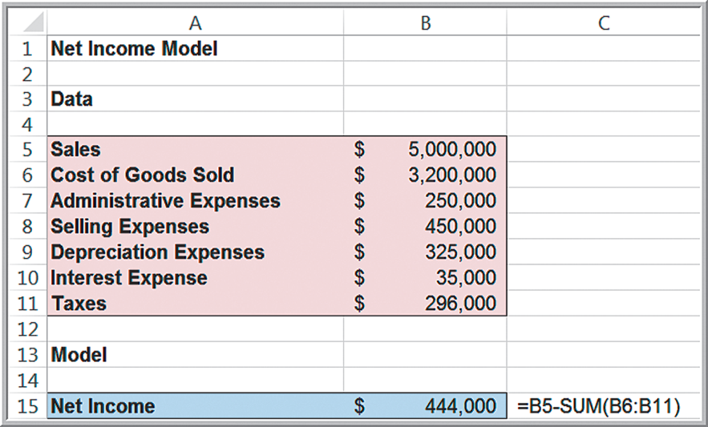
Example 11.5: Modeling Net Income on a Spreadsheet (2 of 4)
Simple model:
net income = sales − cost of goods sold − administrative expenses − selling expenses − depreciation expenses − interest expense − taxes

Slide 15
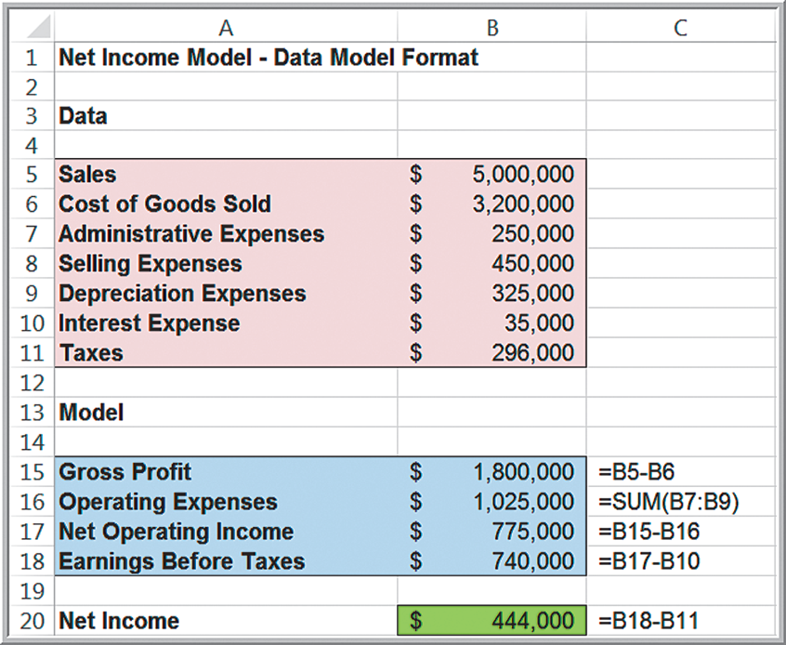
Example 11.5: Modeling Net Income on a Spreadsheet (3 of 4)
Data-model format

Slide 16
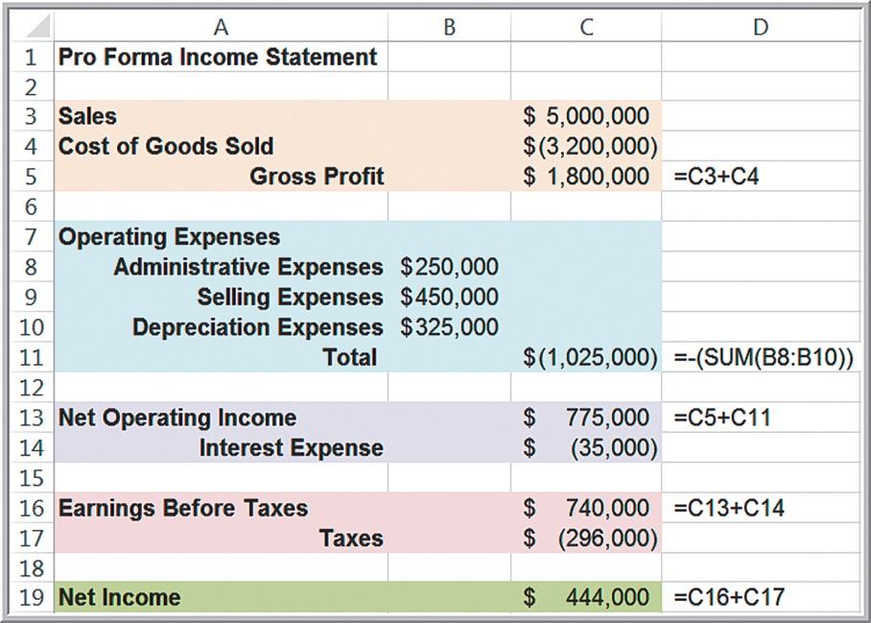
Example 11.5: Modeling Net Income on a Spreadsheet (4 of 4)
Pro forma income statement

Slide 17
Spreadsheet Quality
Building spreadsheet models (called spreadsheet engineering) is part art and part science.
Spreadsheets need to be
accurate,
understandable, and
user friendly.
Verification is the process of ensuring that a model is accurate and free from logical errors.

Slide 18
Improving Spreadsheet Quality
Improve the design and format of the spreadsheet itself.
Sketch a logical design of the spreadsheet.
Break complex formulas into smaller pieces
Design the spreadsheet in a form that the end user can easily interpret and understand
Improve the process used to develop a spreadsheet.
Work on one part at a time
Check formula results with simple numbers
Inspect your results carefully and use appropriate tools available in Excel.
Use Excel auditing tools

Slide 19
Data Validation
An Excel tool that allows you to define acceptable input values in a spreadsheet and provides an error alert if an invalid entry is made.
Data > Data Tools
Select the cell range, click on Data Validation.
Specify the criteria that Excel will use to flag invalid data.

Slide 20
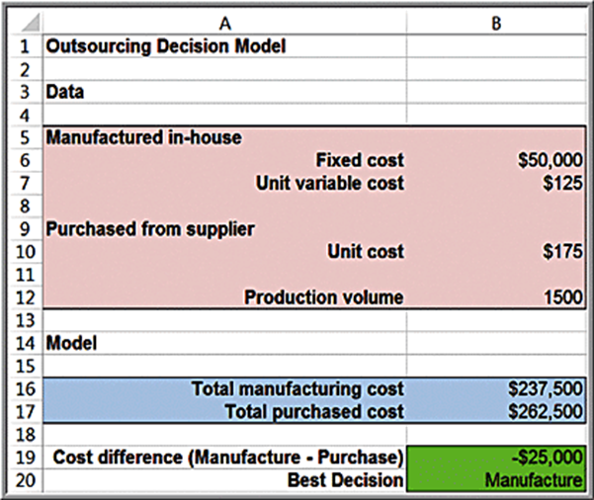
Example 11.6: Using Data Validation (1 of 2)
Outsourcing Decision Model
Suppose that we know that the unit cost of any item is at least $10 but no more than $100.

Slide 21
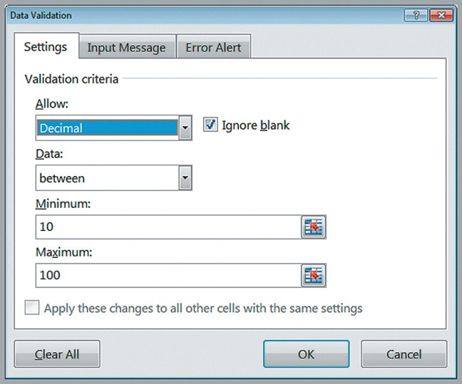
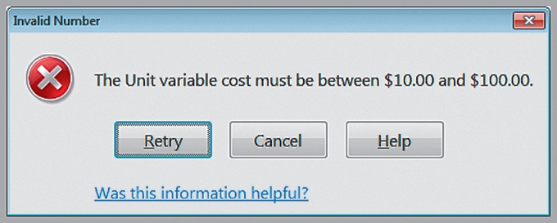
Example 11.6: Using Data Validation (2 of 2)
Data Validation dialog
Error Alert

Slide 22
Descriptive Spreadsheet Models
Descriptive models allow one to answer questions such as
“How many resources do we need to meet estimated demand?”
“What would our profit be under different scenarios?”
A useful spreadsheet model need not be complex!

Slide 23
Staffing Models
Staffing changes can be expensive and time-consuming.
Advance planning is vital so that managers can make good decisions about overtime or reductions in work hours, or adding or reducing temporary or permanent staff.

Slide 24
Example 11.7: A Predictive Model for Staffing (1 of 2)
The manager of a loan processing department wants to know how many employees will be needed over the next several months to process a certain number of loan files per month so she can better plan capacity.
Products | Product Mix | Hours Per File
Product 1 | 22% | 3.50
Product 2 | 17% | 2.00
Product 3 | 13% | 1.50
Product 4 | 12% | 5.50
Product 5 | 9% | 4.00
Product 6 | 9% | 3.00
Product 7 | 6% | 2.00
Product 8 | 5% | 2.00
Product 9 | 3% | 1.50
Product 10 | 1% | 3.50
Misc | 3% | 3.00
Total | 100% | Blank
Different types of products, such as a 30-year fixed
rate mortgage,
or a construction
loan, each varying in complexity and time to complete.
Data:
Forecasts: 700 loan applications in May, 750 in June, 800 in July, and 825 in August.
Each employee works productively for 6.5 hours each day, and there are 22 working days in May, 20 in June, 22 in July, and 22 in August.
Predict the number of full time equivalent (F T E) staff needed each month to ensure that all loans can be processed.

Slide 25
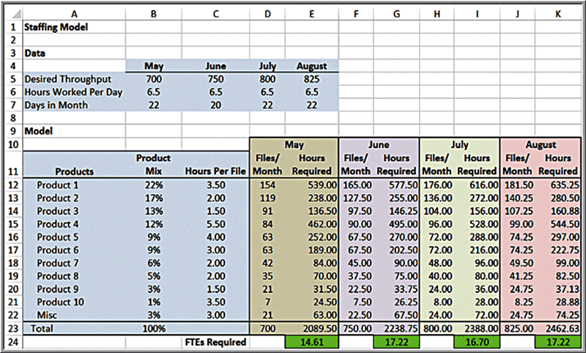
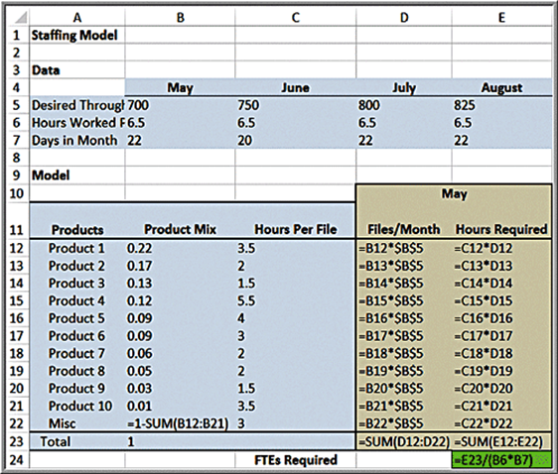
Example 11.7: A Predictive Model for Staffing (2 of 2)
Spreadsheet Model

Slide 26
Single-Period Purchase Decisions
One-time purchase decisions often must be made in the face of uncertain demand.
Newsvendor Problem: How many newspapers to purchase each day?
C = cost to purchase a newspaper
Q = number of newspapers the vendor purchases
D = number of newspapers demanded
R = revenue from selling a newspaper
S = salvage value of unsold newspapers

Slide 27
Example 11.8: A Single-Period Purchase Decision Model (1 of 2)
A small candy store makes Valentine’s Day gift boxes that cost $12 and sell for $18.
In the past, at least 40 boxes have sold by Valentine’s Day but the actual amount is unknown.
After the holiday, boxes are discounted 50%.
C = $12, R = $18, S = $9
Note that D is actually uncertain and can be modeled using a probability distribution.

Slide 28
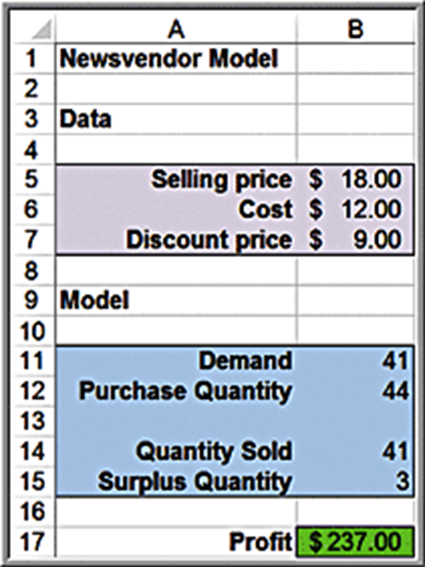
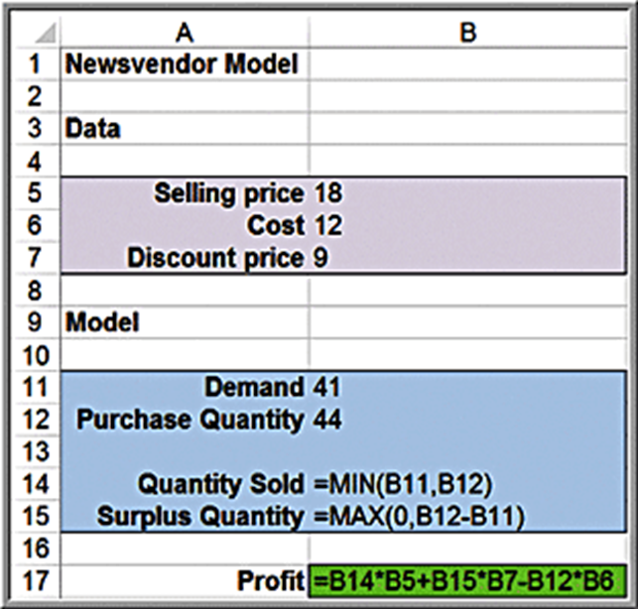
Example 11.8: A Single-Period Purchase Decision Model (2 of 2)
Spreadsheet model

Slide 29
Overbooking Decisions
Find the number of reservations to accept to effectively fill capacity knowing that some customers may not use their reservations.
A common practice in these industries is to overbook reservations.
When more customers arrive than can be handled, the business usually incurs some cost to satisfy them.
Therefore, the decision becomes how much to overbook to balance the costs of overbooking against the lost revenue for underuse.

Slide 30
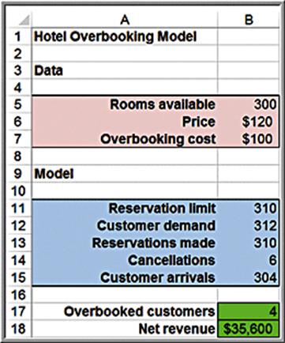
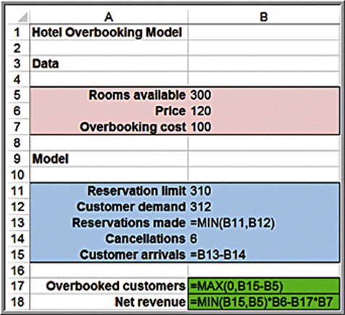
Example 11.9: A Hotel Overbooking Model
A popular resort hotel has 300 rooms.
The room rate is $120 per night.
Reservations can be cancelled by 6:00 p.m.
Cost of overbooking is $100 per occurrence.
Decision variable = number of reservations to accept.
Customer demand and cancellations are actually random variables.

Slide 31
Example 11.10: Modeling Retail Markdown Pricing Decisions (1 of 4)
In the spring, a department store introduces a new line of bathing suits that sell for $70.
The store purchases 1000 of these bathing suits.
During the prime selling season (50 days), the store sells an average of 7 units per day at full price.
Around July 4th, the price is marked down 70% to sell off remaining inventory.
During a special sale, the price was reduced to $49 and sales increased to 32.2 units per day.
If the stored decides to sell at full retail price for x days and then discounts the price by y% for the remainder of the selling season, followed by the clearance sale, what total revenue could they predict?

Slide 32
Example 11.10: Modeling Retail Markdown Pricing Decisions (2 of 4)
Modeling daily sales as a function of price
Assume a linear trend model between sales and price:

Slide 33
Example 11.10: Modeling Retail Markdown Pricing Decisions (3 of 4)
Modeling total revenue
Sell at full retail price for x days:
Full retail price revenue =
Markdown revenue =
Markdown price =
Daily sales =
Units sold at markdown =
as long as this is less than or
equal to the number of units remaining in inventory from full retail sales.
Clearance revenue
Clearance inventory
Clearance price revenue
Total revenue = sum of full retail, markdown, and clearance revenues

Slide 34
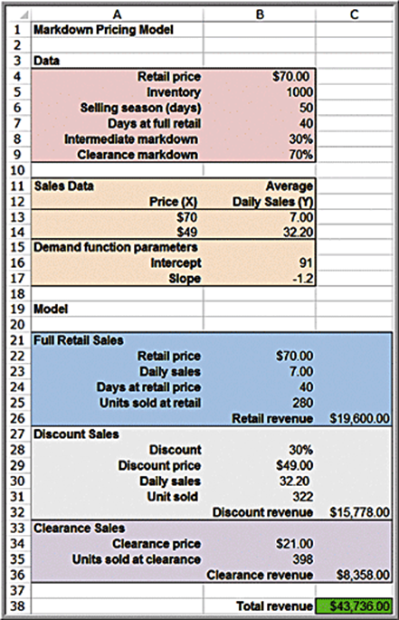
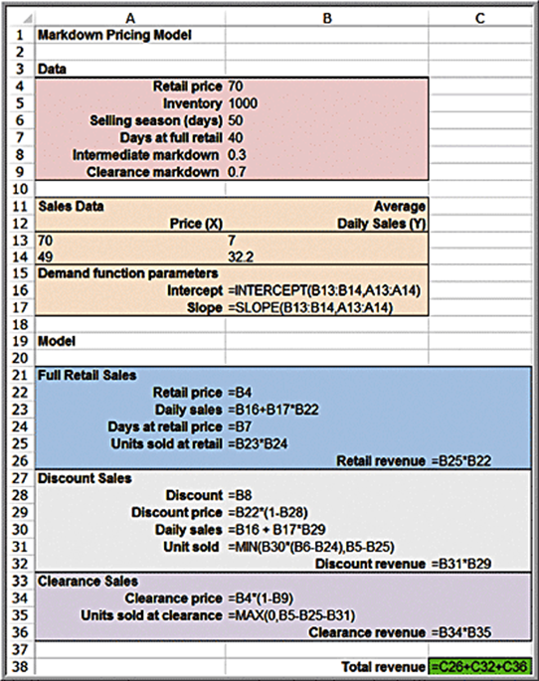
Example 11.10: Modeling Retail Markdown Pricing Decisions (4 of 4)
Spreadsheet model

Slide 35
Predictive Spreadsheet Models
Predictive models focus on understanding the future.
Practical business models focus on predicting financial performance such as profitability or cash flow, customer retention, product sales, and many other key metrics.
Individuals often use spreadsheet models for financial planning, personal budgets, and so on.

Slide 36
Example 11.11: New-Product Development (1 of 3)
Moore Pharmaceuticals needs to decide whether to conduct clinical trials and seek F D A approval for a newly developed drug.
Clinical trials cost = $150 million
Market size = 2 million people
Market size growth = 3% per year
Market share = 8%
Market share growth = 20% per year
Monthly revenue/prescription = $130
Monthly variable cost/prescription = $40
Discount rate = 9%

Slide 37
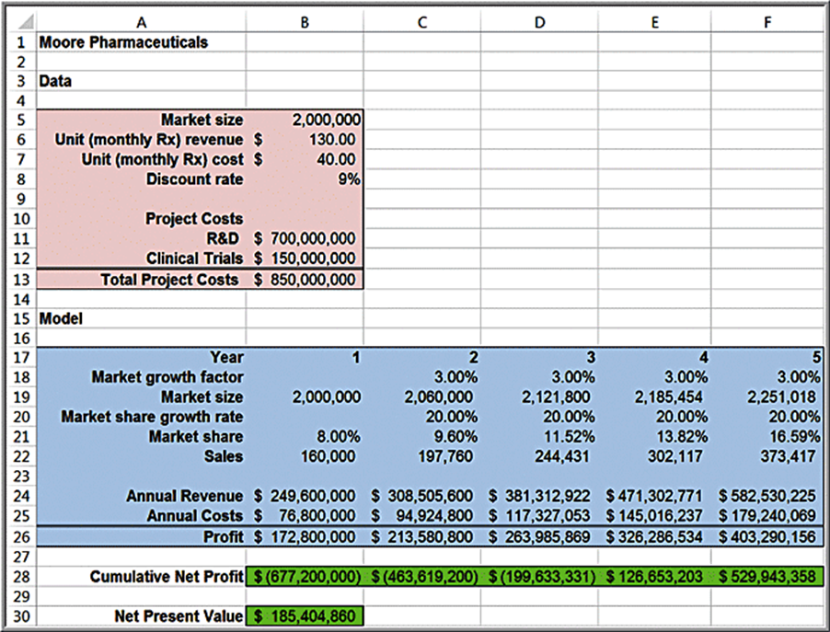
Example 11.11: New-Product Development (2 of 3)
Spreadsheet Model

Slide 38
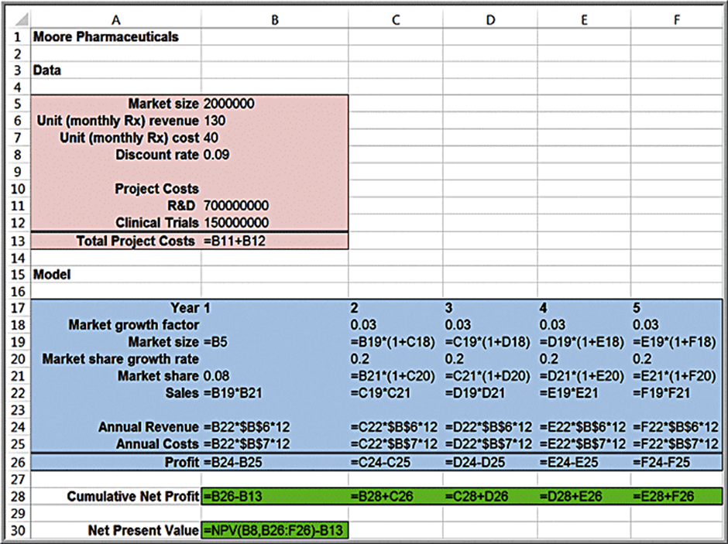
Example 11.11: New-Product Development (3 of 3)
Spreadsheet Formulas

Slide 39
Cash Budgeting
Cash budgeting is the process of projecting and summarizing a company’s cash inflows and outflows expected during a planning horizon, usually 6 to 12 months.

Slide 40
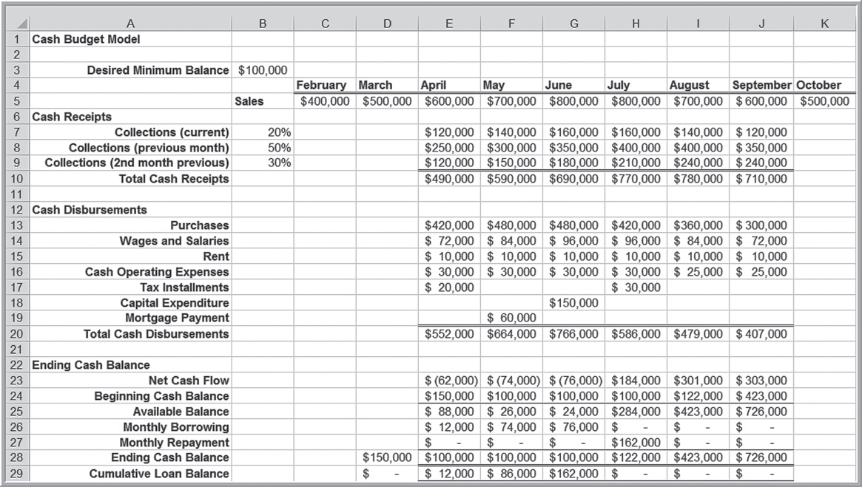
Example 11.12: A Cash Budget Model
Excel file Cash Budget Model

Slide 41
Retirement Planning
Understanding the impact of compounding on investment growth, saving at an early age, and selecting the right portfolio of investments is key to a successful financial future.

Slide 42
Example 11.13: A Retirement-Planning Model (1 of 2)
Starting salary $80,000; age 24, wants to retire at age 60.
Company match of 5% of pre-tax salary for 401(k)
Salary increases 4% per year.
Contribute 15% of pre-tax income to 401(k) account up to $18,000.
Invest in Vanguard Balanced Index Fund, earning 6% per year and Boston Trust Asset Management Fund earning 6.5% per year.
Individuals under age 55 can contribute $5,500 to their Roth I R A annually; and individuals 55 and over can contribute $6,500 into a Roth I R A.

Slide 43
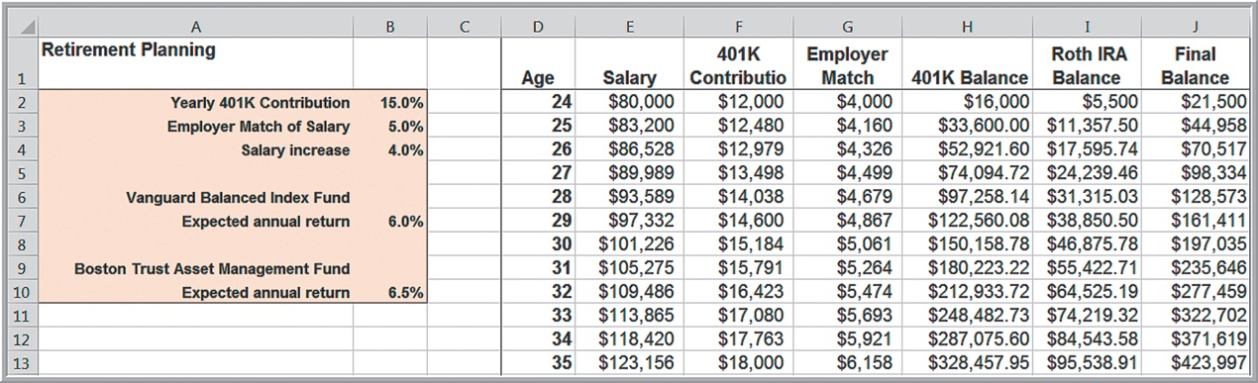
Example 11.13: A Retirement-Planning Model (2 of 2)
Retirement Planning Model assumptions
annual salary increase and returns on investment will be the same each year
annual returns assume that the investment return is applied to the previous year’s balance and not to the current year’s contributions

Slide 44
Project Management
Project management is concerned with scheduling the activities of a project involving interrelated activities.
The longest path through the network defines the minimum project completion time and is called the critical path.
Compute the earliest time that each activity can start and the earliest time it can finish. The earliest time that the last activity can finish is the minimum project completion time.
The difference between the latest finish time and earliest finish time is called the slack. If the slack of an activity is zero, then it is on the critical path.

Slide 45
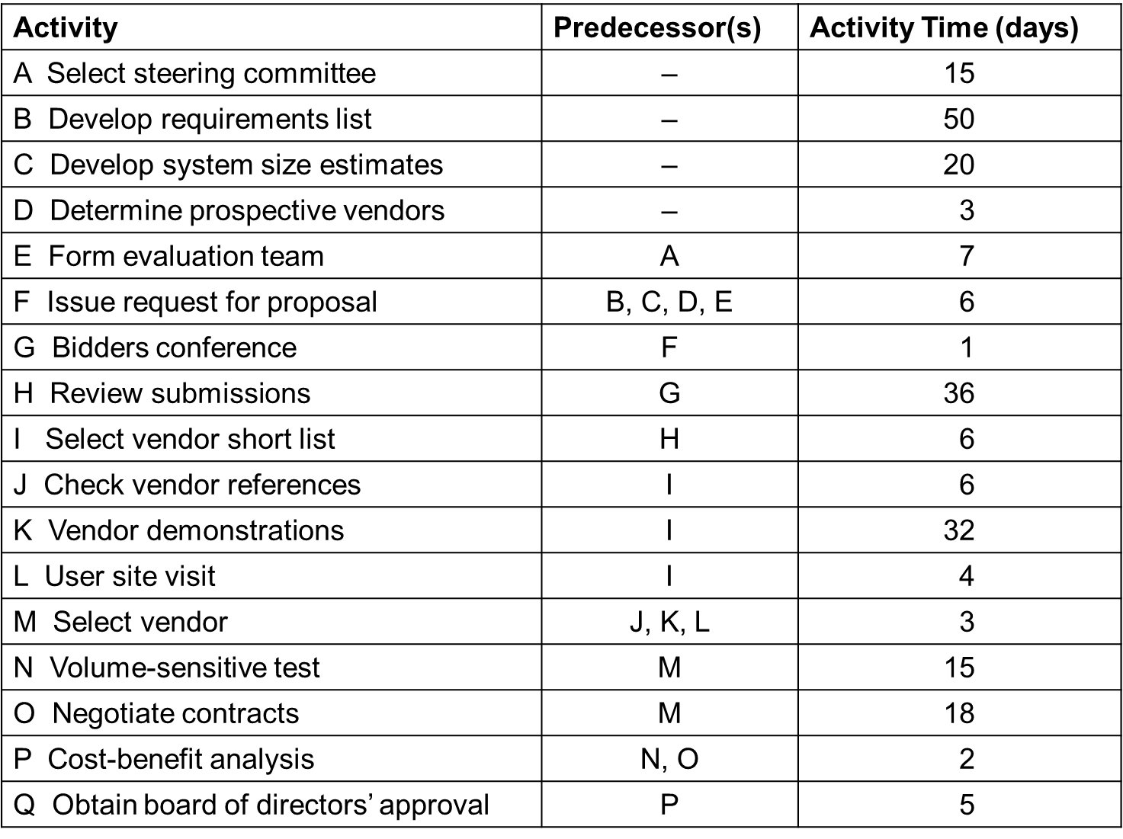
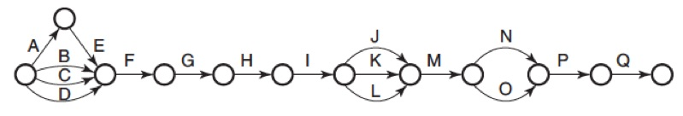
Example 11.14: A Project Management Spreadsheet Model (1 of 3)
Becker Consulting Project Management Model

Slide 46
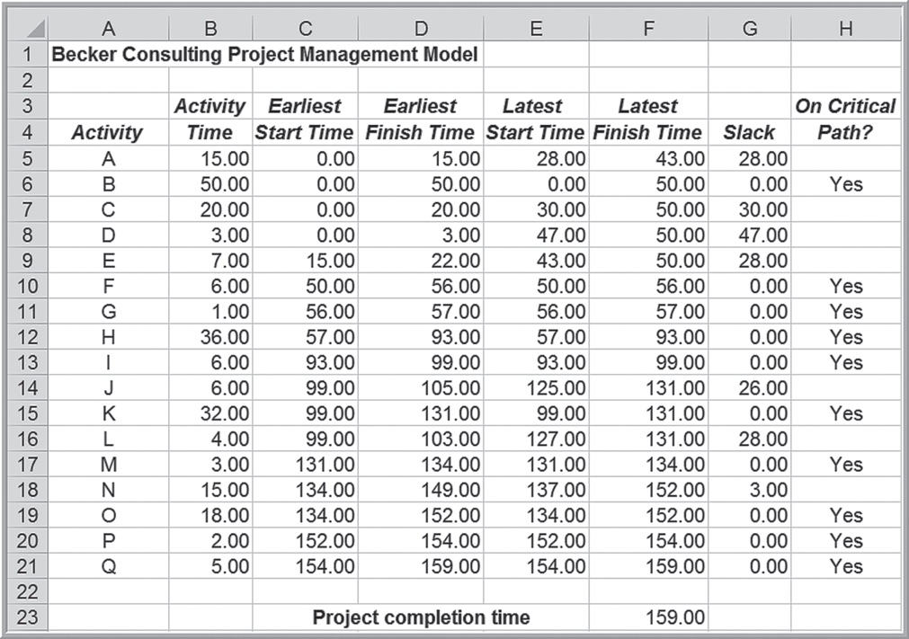
Example 11.14: A Project Management Spreadsheet Model (2 of 3)

Slide 47
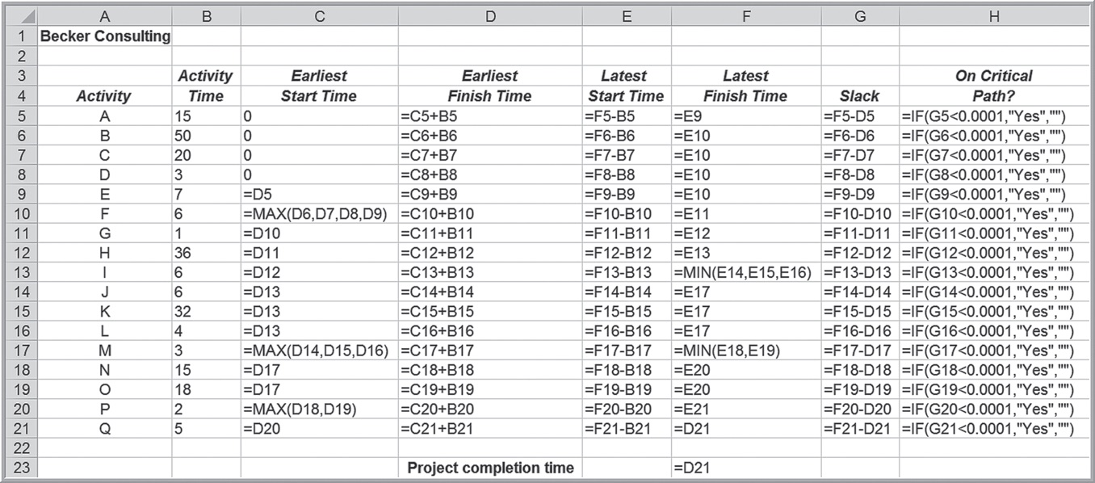
Example 11.14: A Project Management Spreadsheet Model (3 of 3)

Slide 48
Prescriptive Spreadsheet Models
Prescriptive models are often called optimization models.
An optimization model is most often formulated mathematically and specifies
a set of decision variables, numerical quantities that represent the decision options from which to choose;
an objective function that minimizes or maximizes some quantity of interest, profit, revenue, cost, time, and so on;
and constraints, which are limitations, requirements, or other restrictions that are imposed on any solution.

Slide 49
Portfolio Allocation
Selecting investment portfolios is fundamentally a trade-off between return and risk. A major source of uncertainty is the annual return of each asset, leaving the decision maker with the risk of not achieving a desired return.
Other risks include unanticipated changes in inflation or industrial production, the spread between high- and low-grade bonds, and the spread between long- and short-term interest rates.

Slide 50
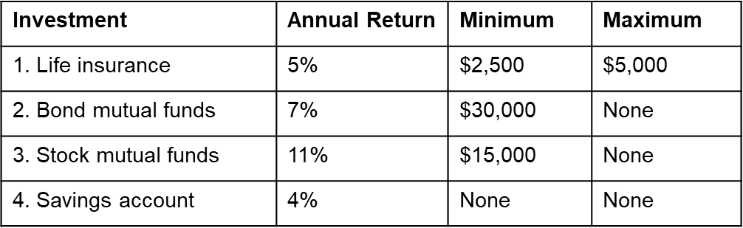
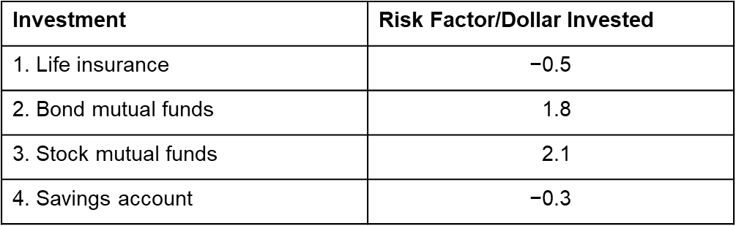
Example 11.15: A Portfolio Allocation Model (1 of 3)
An investor has $100,000 to invest in four assets.

Slide 51
Example 11.15: A Portfolio Allocation Model (2 of 3)
Target level for the weighted risk factor: weighted risk per dollar invested of at most 1.0.
Then the weighted risk for a $100,000 total investment will be limited to 100,000.
The decision problem is to determine how much to invest in each asset to maximize the total expected annual return, remain within the minimum and maximum limits for each investment, and meet the limitation on the weighted risk.

Slide 52
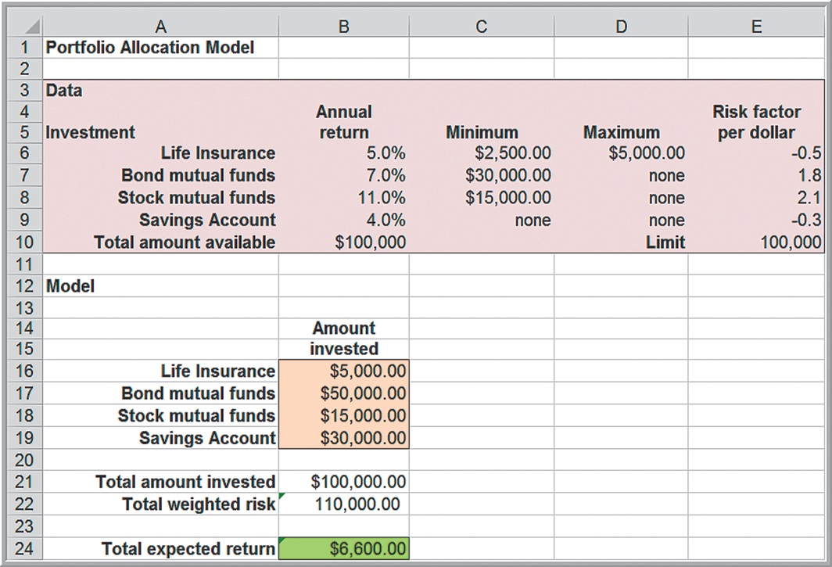
Example 11.15: A Portfolio Allocation Model (3 of 3)

Slide 53
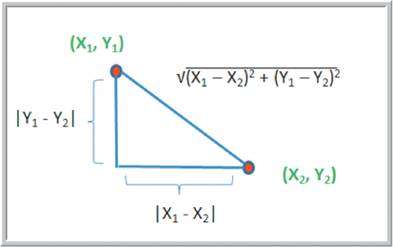
Locating Central Facilities
A common problem in designing service systems is to locate a facility in a “central” location with respect to other facilities to minimize some measure of distance from the central location to each of the other facilities.
Distance measures:
Straight line (Euclidean) distance is the hypotenuse of the triangle.
straight-line distance between
Rectilinear distance is the sum of the left and bottom sides of the triangle.
rectilinear distance between

Slide 54
Example 11.16: Finding the Best Location for a Medical Laboratory (1 of 3)
A medical testing laboratory collects blood samples from 5 local hospitals. Managers want to determine the best location for a new testing facility, taking into consideration both distance and number of trips per month.
Hospital Location | X-Coordinate | Y-Coordinate | Trips/month
1 | 0 | 0 | 5
2 | 20 | 80 | 25
3 | 60 | 30 | 20
4 | 100 | 100 | 35
5 | 70 | 110 | 15

Slide 55
Example 11.16: Finding the Best Location for a Medical Laboratory (2 of 3)
Distance between each hospital and the new facility is assumed to be straight line.
Define
as the coordinates of hospital i
as the coordinates of the laboratory
Hospital Location | X-Coordinate | Y-Coordinate | Trips/month
1 | 0 | 0 | 5
2 | 20 | 80 | 25
3 | 60 | 30 | 20
4 | 100 | 100 | 35
5 | 70 | 110 | 15

Slide 56
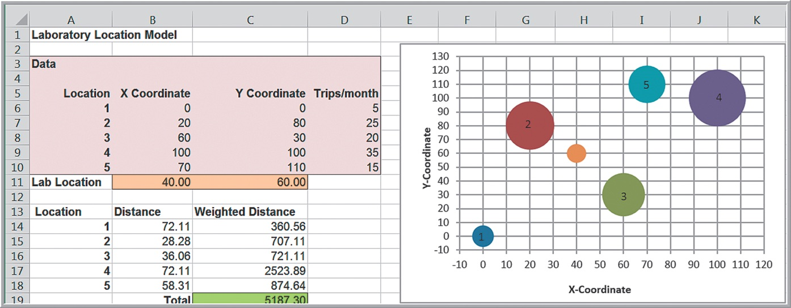
Example 11.16: Finding the Best Location for a Medical Laboratory (3 of 3)

Slide 57
Job Sequencing
Job-sequencing problems involve finding an optimal sequence by which to process jobs.
Lateness
is the difference between completion
time
and due date
Tardiness
is the amount of time by which
completion time exceeds due date:

Slide 58
Sequencing Rules
Shortest processing time (S P T) sequencing of jobs minimizes the average completion time for all jobs.
Earliest due date (E D D) sequencing of jobs minimizes the maximum number of tardy jobs.
Other criteria such as average tardiness, total tardiness, or total lateness are also of interest.

Slide 59
Example 11.17: A Spreadsheet Model for Job Sequencing (1 of 3)
A custom manufacturing company has 10 jobs waiting to be processed.
Processing times and due dates are shown below.
Job | 1 | 2 | 3 | 4 | 5 | 6 | 7 | 8 | 9 | 10
Time | 8 | 7 | 6 | 4 | 10 | 8 | 10 | 5 | 9 | 5
Due date | 20 | 27 | 39 | 28 | 23 | 40 | 25 | 35 | 29 | 30
A sequence of integers for the job ordering is called a permutation.
The goal is to find the permutation that optimizes the chosen criteria.

Slide 60
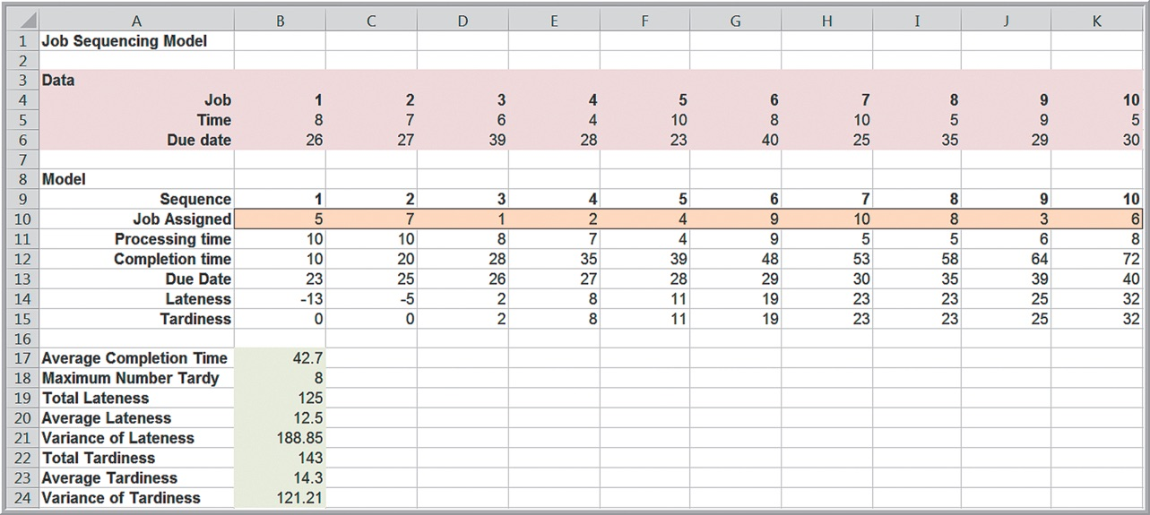
Example 11.17: A Spreadsheet Model for Job Sequencing (2 of 3)

Slide 61
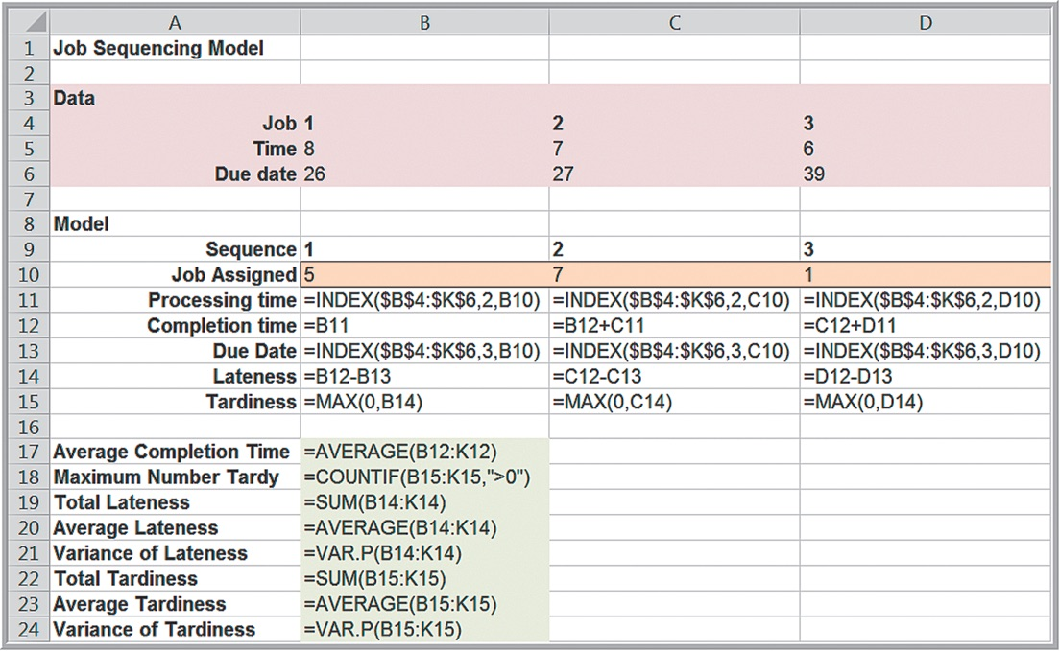
Example 11.17: A Spreadsheet Model for Job Sequencing (3 of 3)

Slide 62
Analyzing Uncertainty and Model Assumptions
Predictive analytical models are based on assumptions about the future and incorporate variables that most likely will not be known with certainty.
It is usually important to investigate how these assumptions and uncertainty affect the model outputs.

Slide 63
What-If Analysis
Spreadsheet models allow you to easily evaluate what-if questions by changing input values and recalculating model outputs.
Systematic approaches to what-if analysis that are available in Excel make the process easier and more useful.
Data tables
Scenario Manager
Goal Seek

Slide 64
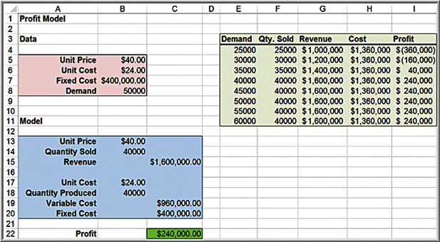
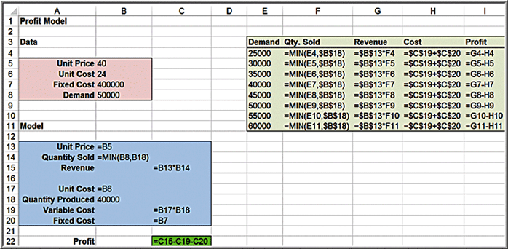
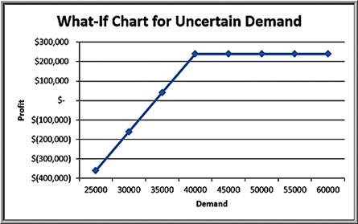
Example 11.18: Using Excel for What-If Analysis
Uncertain demand in the Profit Model
Excel table using formulas:
Visualization of profit:

Slide 65
Data Tables
Data Tables summarize the impact of one or two inputs on a specified output.
A one-way data table evaluates an output variable over a range of values for a single input variable.
Two-way data tables evaluate an output variable over a range of values for two different input variables.

Slide 66
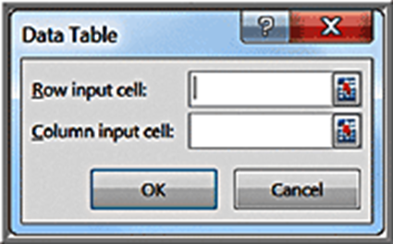
Creating One-Way (Column) Data Tables in Excel
Create a range of values for some input cell in your model that you wish to vary.
Enter the cell reference for the output variable in your model that you wish to evaluate in the row above the first value and one cell to the right of the column of input values.
Select the range of cells that contains both the formulas and values you want to substitute.
Type the cell reference for the input cell in your model in the Column input cell box.

Slide 67
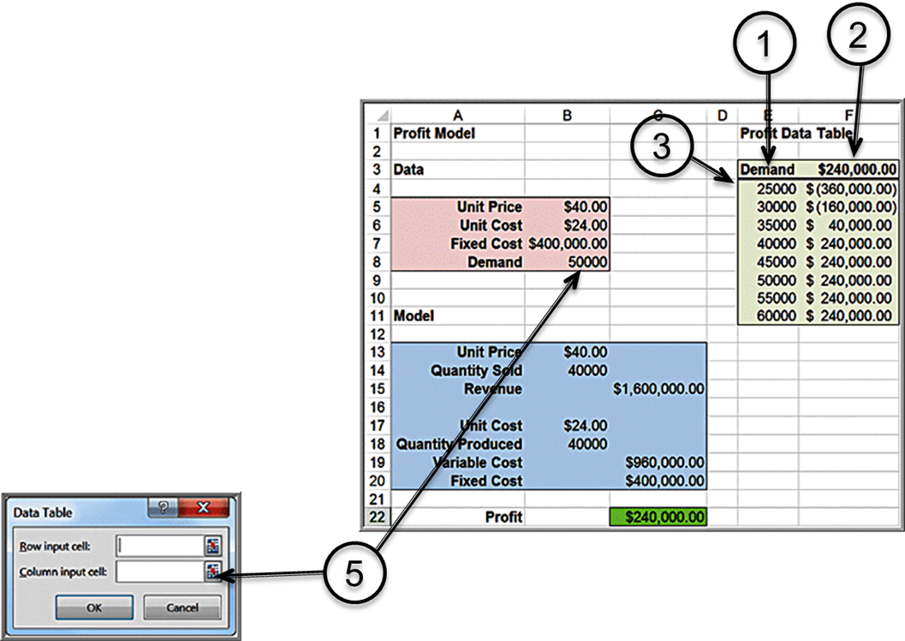
Example 11.19: A One-Way Data Table for Uncertain Demand
Create a column of demand values (column E).
Enter =C22 in cell F3 (to reference the output cell).
Highlight the range
Enter B8 for Column input cell in the Data Table dialog (tells Excel that column E refers to demand)

Slide 68
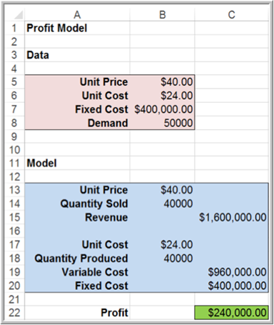
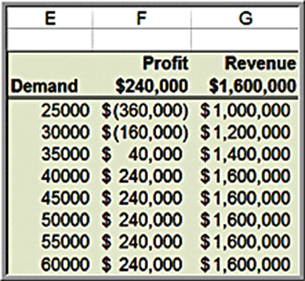
Example 11.20: One-Way Data Tables with Multiple Outputs
Create a second output column for revenue.
Enter =C15 into cell G3.
Highlight
Enter B8 for Column input cell in the Data Table dialog.

Slide 69
Two-Way Data Tables
Type a list of values for one input variable in a column and a list of input values for the second input variable in a row, starting one row above and one column to the right of the column list.
In the cell in the upper left-hand corner immediately above the column list and to the left of the row list, enter the cell reference of the output variable you wish to evaluate.
Select the range of cells that contain this cell reference and both the row and column of values.
In the Row input cell of the dialog box, enter the reference for the input cell in the model that corresponds to the input values in the row.
In the Column input cell box, enter the reference for the input cell in the model that corresponds to the input values in the column.

Slide 70

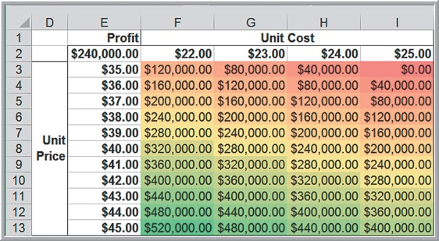
Example 11.21: A Two-Way Data Table for the Profit Model
Evaluate the impact of both unit price and unit cost.
Create a column of unit prices.
Create a row of unit costs.
Enter =C22 in upper left corner.
Select range of data (not including headings).
In Data Table dialog
Enter B6 for Row input cell.
Enter B5 for Column input cell.

Slide 71
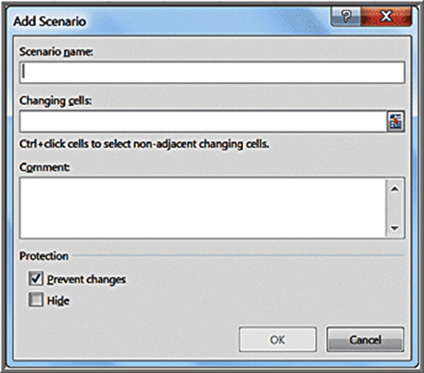
Scenario Manager
Allows creation of scenarios - sets of values that are saved and can be substituted in worksheets.
Click Add button to open Add Scenario dialog.
Enter a Scenario Name.
In Changing Cells box, enter cell references to include in scenario.
In the Scenario Values dialog enter values for each of the changing cells.
Click Show button to display the results.

Slide 72
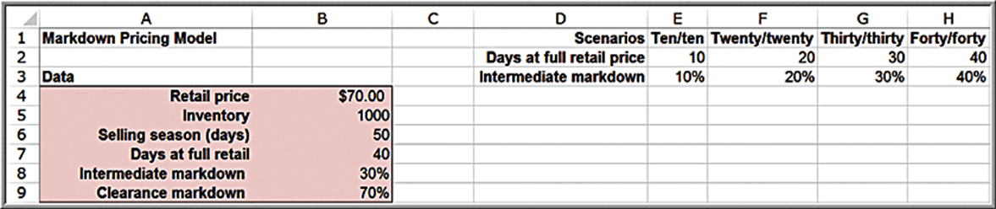
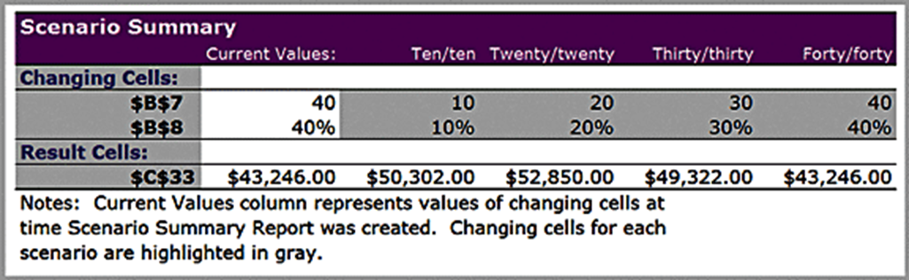
Example 11.22: Using the Scenario Manager for the Markdown Pricing Model
Evaluate 4 strategies for pricing and discounts on the bathing suits in the Markdown Pricing Model.

Slide 73
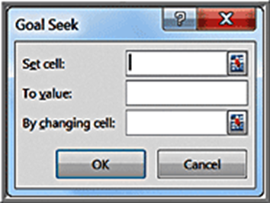
Goal Seek
If you know the result that you want from a formula but are not sure what input value the formula needs to get that result, use the Goal Seek feature in Excel.
Set cell contains the cell reference for the formula you want to resolve.
To value is the target value you want the formula to return.
By changing cell is the reference of the input value that you want to change to achieve the set cell value.

Slide 74
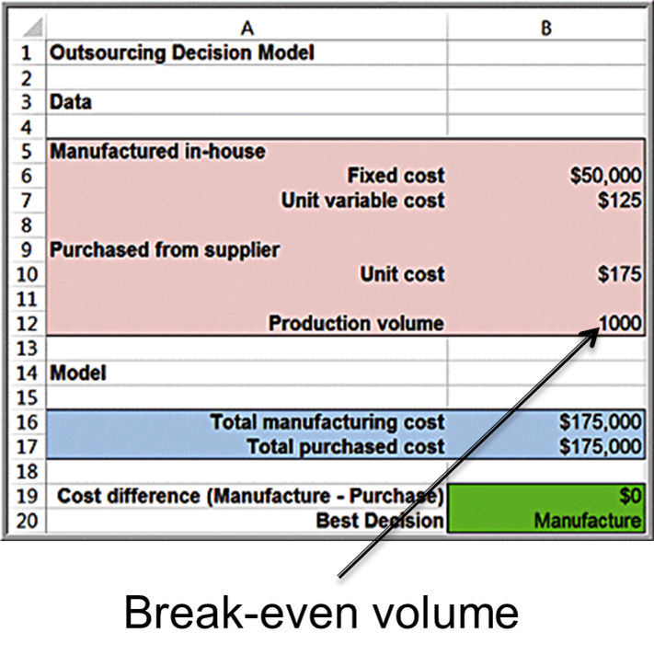

Example 11.23: Finding the Break-Even Point in the Outsourcing Model
Find the value of demand for which manufacturing cost equals purchased cost.
Set cell: B19
To value: 0
By changing cell: B12.

